Slide 1
Secure Data Hiding in Image Using Steganography
CAPSTONE PROJECT
Presented By: Vinayak Mehta
Student Name : Vinayak Mehta
College Name & Department : Parul Institute of Technology, CSE

Slide 2
OUTLINE
Problem Statement
Technology used
Wow factor
End users
Result
Conclusion
Git-hub Link
Future scope

Slide 3
Problem Statement
In today's digital world, securing sensitive information is a major challenge. Traditional encryption methods can make the presence of hidden messages obvious, attracting unwanted attention. Steganography, the practice of concealing data within other media, offers an alternative approach. This project focuses on embedding secret messages inside images using steganography. By slightly modifying pixel values, data can be securely hidden without visible distortion. The project ensures that only authorized users with the correct passcode can retrieve the hidden message, making it an effective tool for covert communication.

Slide 4
Technology used
Programming Language:
Python – Used for writing the script and implementing the logic.
Libraries & Frameworks:
OpenCV (cv2): Used for reading, modifying, and saving image files.
NumPy: Helps in handling pixel-level modifications efficiently.
Tkinter – To build the GUI for user interaction.
PIL (Pillow) – For handling image formats and conversion.
Platform Compatibility:
Works on Windows, Linux, and macOS with Python installed.

Slide 5
Wow factors
Invisible Message Embedding:
The hidden message does not alter the image visually, making detection difficult.
Passcode-Protected Decryption:
Only users with the correct passcode can extract the secret message, adding an extra security layer.
Dual Interface:
Separate encoding and decoding interfaces for better user experience.
Cross-Platform Compatibility:
Works on multiple operating systems and supports different image formats (JPEG, PNG, BMP).
Automatic Image Preview:
Displays encrypted image upon successful encoding.

Slide 6
End users
This project is beneficial for various domains, including:
🔹 Cybersecurity Professionals:
Secure communication without attracting attention.
🔹 Government & Intelligence Agencies:
Protect confidential data from being intercepted.
🔹 Journalists & Whistleblowers:
Share sensitive information securely without leaving traces.
🔹 Military & Defense Organizations:
Covert communication in high-security environments.
🔹 Individuals Concerned About Privacy:
Protect personal information from cyber threats.

Slide 7
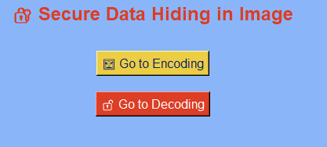
Results
Output - GUI

Slide 8
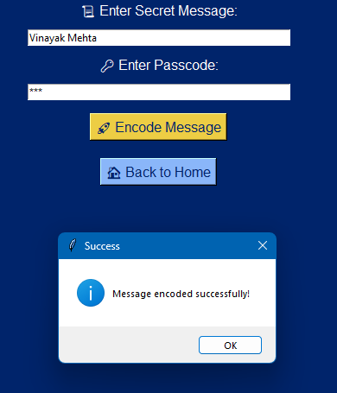
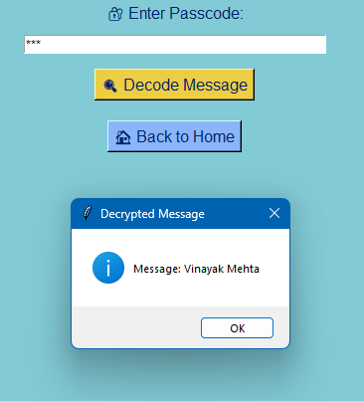
Results
Encryption Output
Decryption Output

Slide 9
Conclusion
With increasing concerns over data security, this project provides a discreet way to hide sensitive information within images without altering their visual appearance. By leveraging pixel manipulation and passcode protection, it ensures that only authorized users can access the hidden message. Unlike traditional encryption, this method does not raise suspicion, making it ideal for secure communication in cybersecurity, journalism, and intelligence fields.
This project demonstrates the effectiveness of image-based steganography for covert data transmission. Future improvements, such as stronger encryption, multi-format support, and a user-friendly interface, can further enhance its applicability in real-world scenarios.

Slide 10
GitHub Link
GitHub Repository :-
https://github.com/VinayakMehta007/Secure-Data-Hiding-in-Image-Using-Steganography.git

Slide 11
Future scope
🔹 Implement Stronger Encryption:
Use AES (Advanced Encryption Standard) or RSA encryption before embedding the message for an additional layer of security.
🔹 Support for Multiple Image Formats:
Extend support for various formats, including PNG, BMP, and TIFF, for better compatibility.
🔹 Error Detection & Correction:
Implement redundancy checks to prevent message corruption during transmission.
🔹 Cloud-Based Implementation:
Develop an online tool that allows users to upload an image, hide a message, and download the modified image securely.

Slide 12
THANK YOU

